Slide 1
Quality Alloys, Inc.
Team 6- Valencia
Coelho・ Gao ・ Pontioso ・ Ren ・ Torres ・ Vashisht

Slide 2
Quality Alloys, Inc. (QA)
Annual Sales: $75 million
US-based distributor of different grades of alloys used in industrial manufacturing.
Introduces products through direct mail, advertising in magazines, paid listings: GlobalSpec and ThomasNet

Slide 3
QA Financials
2008
2009
Revenue: -28%
Profit: -33%
Notes:
Due to many factors: financial crisis: was a severe worldwide economic crisis we ever had, not targeting the right market

Slide 4
Business Questions
How many people visit the website? How do they come to the website?
Is the website and promotion generating web traffic, and does this interest yield actual sales?
Do traditional promotions drive web traffic, and in turn drive incremental sales?
How can visits to the website best be modeled?
Where and how should QA advertise?

Slide 5
Question 1
How many people visit the website? How do they come to the website?

Slide 6
Unique Visits Per Week
Initial
Pre-Promo
Promo
Post-Promo
Unique Visits
Brochure
Mid-Dec
$25K
Week
2008
2009
Notes:
Pre-Promo: sent by mid December 2008 (investment 25$)
Promotion: Campaign was successful in terms of brand awareness: bringing lots of unique visitors to the website, however that doesn’t necessary mean that those unique visitors brought more revenues to QA.

Slide 7
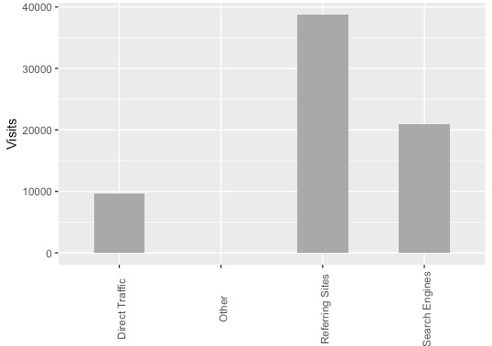
Visits Per Traffic Source
+50%
+30%
Visits
Traffic Sources
Notes:
Where are these visitors coming from?
+50% visits comes from Referring Sites / +30% Search Engines
And from both Traffic sources, around 80% comes from Google

Slide 8
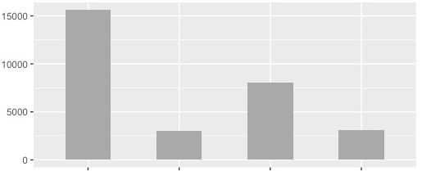
Visits Per Referring Site
Visits
Google
AdWords
Other
Google
AdWords
sedoparking.com
Referring Sites
Notes:
Here are the graphs that support our statement

Slide 9
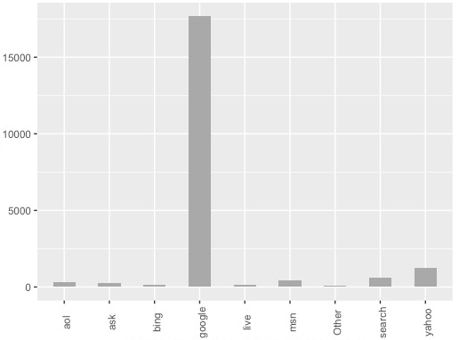
Visits Per Search Engine Source
Visits
Search Engine Source
Notes:
Same here.

Slide 10
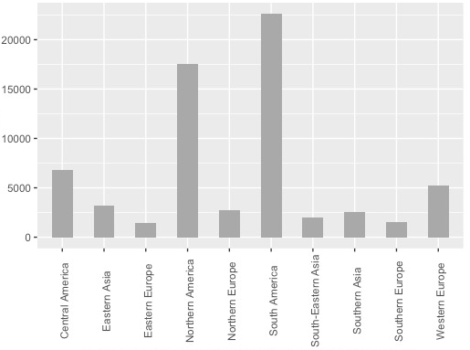
Visits Per Sub-Continent Region
Visits
Sub-Continent Region
Notes:
Now, we can see high percentage of visits from North, South and Central America. We shouldn't be surprised by these results because they are focusing their promotion strategy in google and google AdWords. The most important search engine source in the Americas.
What happened with the company goal, to enter and reach the Asian market? If the Asian market was viewed as particularly important to QA, they are clearly not investing in the right search engines commonly used in that region. Google for example is banned from China. Cleary the strategy is not going to work in that market.
One of our recommendations is target search engines that are more popular in the Asian market like Japan - Yahoo and China - Baidu

Slide 11
Question 2
Is the website generating interest, and does this interest yield actual sales?

Slide 12
Correlations
Lbs. Sold
Bounce Rate
Lbs. Sold
Bounce Rate
Visits
Profit
Inquiries
Visits
Profit
Inquiries
Visits
Profit
INITIAL
PRE-PROMO
Lbs. Sold
Inquiries
Bounce Rate
Visits
Profit
PROMOTION
Lbs. Sold
POST - PROMOTION
Inquiries
Bounce Rate
Notes:
Initial period strong correlation between bounce and visits.
During prepromotion bounce rate and visits dropped for a tiny amount.
Promo remained the same, but we should take note that pounds sold and profit had a stronger correlation.
However this does not mean that when page visitors familiarize themselves with website does mean that they are more likely to do business with us. Post-promo least bounce rate but compared to the other periods, it showed us the weakest correlation between profit and bounce rate. And as we can see, correlation between profit and pounds sold weakened during this period.

Slide 13
Question 3
Do traditional promotions drive web traffic, and in turn, drive incremental sales?

Slide 14
Unique Visits Per Week
Initial
Pre-Promo
Promo
Post-Promo
Unique Visits
Brochure
Mid-Dec
Week
2008
2009
Notes:
Yes. We released our brochure during the middle of December, 2008. After a few weeks we could see that we have caught a lot of attention to our website.

Slide 15
Means
 | Visits | Unique Visits | Revenue | Profit | Lbs. Sold
Initial | 891 | 834 | 483,877 | 143,536 | 18,251
Pre-promotion | 1032 | 969 | 513,370 | 158,731 | 17,601
Promotion | 1587 | 1508 | 440,423 | 137,420 | 15,378
Post-promotion | 594 | 545 | 546,916 | 162,879 | 18,430
Notes:
However, during the peak popularity of our website, which is during the promotion period, our revenue and units sold are also at the lowest compared to the other 3 periods.

Slide 16
Relationship Between Variables
Revenue
Visits
Lbs. Sold
Revenue
Notes:
To discuss the issue further, there is a positive correlation between pounds sold and our revenue which is pretty self-explanatory. However, the bias between the correlation of visits and revenue is really strong. Which is also quite self-explanatory because QA does not have an add to cart feature on their website, so profile visits are a

Slide 17
Page Visitors
Upper Quartile
Upper Quartile
Lower Quartile
Lower Quartile
Notes:
75% of unique visits lie below 1,300 mark for unique visits. Outliers are from the promotion period.

Slide 18
Pounds Sold Per Week
Initial
Pre-Promo
Promo
Post-Promo
Pounds Sold
Week
2008
2009
Notes:
To further further discuss the question, we could see that even during the pre-promotion period we have our highest units sold. And during the initial period we could see that we have relatively more pounds sold during the post-promotional period.

Slide 19
Profits Per Week
Initial
Pre-Promo
Promo
Post-Promo
Profit
Week
2008
2009

Slide 20
Question 4
How can visits to the website best be modeled?

Slide 21
Modelling
Probability Regression;
99,98% of the variance of the Visits explained:
Page/Visits;
Bounce Rate;
% of New Visits
Page Views Lower P-value → Best Variables
Unique Views

Slide 22
Question 5
Where and how should QA advertise?

Slide 23
Where and how should QA advertise?
New Strategy for Asian Market
Translating the website not enough:
Choose the right search engine to invest our budget (Yahoo and Baidu);
Create a native experiences for users everywhere
Invest more in page listings where we can target industry experts that know about QA and are willing to purchase our product
We can also backlink our content in engineering blogs or aircraft online magazines
Notes:
1. Japan – Yahoo, China -Baidu
A product wins if they think you are local

Slide 24
Long-Term Recommendations
To do predictive analysis/forecasting we need more data.
Data from all the industries which use our product so we can better target specific industries and target those industries.
We can combine industry data with geographical regions to understand where and which markets to more focus on.
We need data from top competitors in Asia to understand the needs of markets.
Notes:
We need more data with around 60 observation we ca not take big decisions.

Slide 25
Q&A

Slide 26
APPENDIX

Slide 27
General Information
Customers are generally small companies that make parts out of the alloys they purchase.
These customers do not inventory the alloys purchased from QA. They typically purchase what they need for specific jobs they have in hand.
One purchase may not be an accurate predictor of future purchases; that is, one purchase may not signal what will be purchased in the future, or when a future purchase will occur.
QA decided to extend its marketing reach by establishing a company web presence. The goals of the company’s website were to (a) drive new sales, (b) make product and contact information available, and (c) give or add legitimacy to its brand.
There’s no direct way to connect a visit with a sale as there is no “shopping cart” on the website. Customers can ask for quotations
QA commissioned a professionally produced brochure providing an overview of the company’s products and services and sent it to potential customers in mid-December 2008.
For B2B websites without “shopping cart” functionality the task is considerably more challenging.

Slide 28
Modelling (Code)

